Slide 1
HS Corpus Linguistics / Korpuslinguistik 4. Corpus design & linguistic annotation
Prof. Dr. Stephanie Evert
Chair of Computational Corpus Linguistics
www.linguistik.uni-erlangen.de

Slide 2
What is representativeness?
representative random sample
population
(of “objects”)
Statistics (hypothesis tests)
corpus data
(frequencies)
operationalized
hypothesis
about “language”
linguistic research question
Notes:
Recall the first steps / design of a corpus study
Conclusion: corpus should be a representative sample of the “language” to be studied in the sense of a statistical random sample

Slide 3
Goals of corpus design
Representativeness
a corpus should be representative of the (sub-)language to be studied
statistics: random sample
full representativeness difficult to achieve
must at least be balanced (= good coverage of different registers, speakers, …)
and avoid bias or skew towards any particular group of speakers, text type, topic, …
Comparability
corpus linguistic analysis often builds on frequency comparison between different corpora or sub-corpora
prerequisite: comparable corpora

Slide 4
Representativeness & sampling
Statistics: completely random sample
extensional population of interest, i.e. a (possibly infinite) collection of objects
randomly select n objects from population
But what about language?
Design criteria ➞ sampling frame
dices up and defines linguistic population ➞ make relevant texts identifiable
“A sampling frame is an operational definition of the population, an itemized listing of population members from which a representative corpus can be chosen.” (Biber 1993, 244)
pick specified number of items from each cell (related to stratified sampling)
language
spoken
written
sampling frame
Notes:
sampling frame dices up linguistics population based on metadata categories
e.g. spoken vs. written; age group of speaker/author; text type / genre; …
categories often “orthogonal” to each other, but sometimes different subdivisions (e.g. text type | mode)
find specified number of available text for each cell of the grid ➞ ensures balance, approximates random sampling

Slide 5
Representativeness & sampling
Definition of a sampling frame
fundamental distinctions: mode (spoken/written/written-to-be-spoken), medium
text characteristics: (publication) date, author (single/multi/anon), region, target audience, …
function of text: genre / text type (factuality, purpose, situation, …), topic domain, …
properties of author/speaker: sex, age, dialect, social class, …
see Atkins et al. (1992) for a comprehensive system of categories
Balance
include texts from all (combinations of) categories in the sampling frame = grid cells
avoids bias/skew ➞ balanced coverage of the “language” population
Representativeness
sampling frame makes population identifiable (for each combination of categories) ➞ random selection of texts for each cell
must specifiy proportion of texts to be sampled from each category = prevalence in language

Slide 6
Further reading
Atkins, Sue; Clear, Jeremy; Ostler, Nicholas (1992). Corpus design criteria. Literary and Linguistic Computing, 7(1), 1–16.
Biber, Douglas (1993). Representativeness in corpus design. Literary and Linguistic Computing, 8(4), 243– 257.
HSK 29.1 Corpus Linguistics, Art. 9
HSK 5.4 Dictionaries: Computational Lexicography, Art. 96 (Ch. XVIII)

Slide 7
Brainstorming
How would you design a corpus for a study of evaluative language in music reviews?
… or another research question?

Slide 8
Assignment of presentation topics

Slide 9
A corpus consists of …
Object data = texts
primary data, main object of analysis
Metadata = information about the texts
title, author, publication date, text type, medium, …
age, sex, education, region, dialect, … of authors
always include all variables used to define sampling frame
Typographic markup & text structure
paragraphs, headings, bold/italics, typeface, itemized lists, footnotes, …
Annotation = linguistic interpretation
simple (token level) vs. structured (e.g. syntax tree)
essential for querying and analyzing large corpora

Slide 10
Corpus annotation: raw text + metadata
It seemed a day much as any other until I happened to look out of the back window. There was a little garden behind the house; a well-mown lawn surrounded by a neatly cut hedge, a few bushes and colourful flowers.
metadata
title: The Garden
author: Stefan Evert
author sex: male date: 05.08.1991

Slide 11
Corpus annotation: tokenization
It seemed a day much as any other until I happened to look out of the back window . There was a little garden behind the house ; a well-mown lawn surrounded by a neatly cut hedge , a few bushes and colourful flowers .

Slide 12
Corpus annotation: sentence segmentation
<s> It seemed a day much as any other until I happened to look out of the back window . </s>
<s> There was a little garden behind the house ; a well-mown lawn surrounded by a neatly cut hedge , a few bushes and colourful flowers . </s>

Slide 13
Corpus annotation: part-of-speech (POS) tagging
<s> It_{PP} seemed_{VBD} a_{DT} day_{NN} much_{RB} as_{IN} any_{DT} other_{JJ} until_{IN} I_{PP} happened_{VBD} to_{TO} look_{VB} out_{RP} of_{IN} the_{DT} back_{JJ} window_{NN} ._{SENT} </s>
<s> There_{EX} was_{VBD} a_{DT} little_{JJ} garden_{NN} behind_{IN} the_{DT} house_{NN} ;: a_{DT} well-mown_{VBN} lawn_{NN} surrounded_{VBN} by_{IN} a_{DT} neatly_{RB} cut_{VBN} hedge_{NN} ,, a_{DT} few_{JJ} bushes_{NNS} and_{CC} colourful_{JJ} flowers_{NNS} ._{SENT} </s>

Slide 14
English: Penn tagset * with TreeTagger-internal modifications
*
*
*
*
*
*
*
*
*
*
*
*
*

Slide 15
German: STTS tagset

Slide 16
Manual annotation
Manual annotation for small, high-quality corpora
e.g. digital edition, political speeches, poetry/song texts, …
Annotation schema and categories
Guidelines = detailed instructions for annotators
plus collection of examples for unclear / difficult cases
Annotation tools (usually Web-based)
e.g. INCEpTION (https://inception-project.github.io), Prodigy (https://prodi.gy)
Inter-Annotator Agreement (IAA)
reliability and validity of the annotation
annotator mistakes vs. systematic differences
Notes:
Reliabilität = Mess- bzw. Annotationsfehler
Validität = Aussagekraft bzw. Messbarkeit, wird durch systematische Differenzen in Frage gestellt

Slide 17
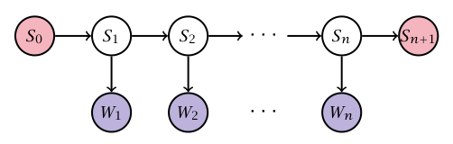
Automatic annotation
Most successful approach: machine learning
Need to cast annotation as classification task
Gold standard = corpus with manual annotation
annotation must be consistent, errors seem unproblematic
separate into training, development and test data
Example: tagging with Hidden Markov Model (HMM)
see e.g. Brants (2000), Schmid (1995)
(Evert et al. 2009)

Slide 18
Corpus annotation: lemmatization
<s> It_{PP} seemed_{VBD} a_{DT} day_{NN} much_{RB} as_{IN} any_{DT} other_{JJ} until_{IN} I_{PP} happened_{VBD} to_{TO} look_{VB} out_{RP} of_{IN} the_{DT} back_{JJ} window_{NN} ._{SENT} </s>
<s> There_{EX} was_{VBD} a_{DT} little_{JJ} garden_{NN} behind_{IN} the_{DT} house_{NN} ;: a_{DT} well-mown_{VBN} lawn_{NN} surrounded_{VBN} by_{IN} a_{DT} neatly_{RB} cut_{VBN} hedge_{NN} ,, a_{DT} few_{JJ} bushes_{NNS} and_{CC} colourful_{JJ} flowers_{NNS} ._{SENT} </s>

Slide 19
Corpus annotation: lemmatization
<s> It_{PP}^{it} seemed_{VBD}^{seem} a_{DT}ª day_{NN}^{day} much_{RB}^{much} as_{IN}^{as} any_{DT}^{any} other_{JJ}^{other} until_{IN}^{until} I_{PP}^{I} happened_{VBD}^{happen} to_{TO}^{to} look_{VB}^{look} out_{RP}^{out} of_{IN}^{of} the_{DT}^{the} back_{JJ}^{back} window_{NN}^{window} ._{SENT}. </s>
<s> There_{EX}^{there} was_{VBD}^{be} a_{DT}ª little_{JJ}^{little} garden_{NN}^{garden} behind_{IN}^{behind} the_{DT}^{the} house_{NN}^{house} ;:; a_{DT}ª well-mown_{VBN}??? lawn_{NN}^{lawn} surrounded_{VBN}^{surround} by_{IN}^{by} a_{DT}ª neatly_{RB}^{neatly} cut_{VBN}^{cut} hedge_{NN}^{hedge} ,,, a_{DT}ª few_{JJ}^{few} bushes_{NNS}^{bush} and_{CC}^{and} colourful_{JJ}^{colorful} flowers_{NNS}^{flower} ._{SENT}. </s>
need better representation format

Slide 20
XML markup of annotation Standard for data interchange & archiving
root element
element annotated with attributes
<corpus>
<story num="6" title="The Garden">
<p>
<s>
<token pos="PP" lemma="it">It</token>
<token pos="VBD" lemma="seem">seemed</token>
<token pos="DT" lemma="a">a</token>
<token pos="NN" lemma="day">day</token>
<token pos="RB" lemma="much">much</token>
<token pos="IN" lemma="as">as</token>
<token pos="DT" lemma="any">any</token>
<token pos="JJ" lemma="other">other</token>
<token pos="IN" lemma="until">until</token>
<token pos="PP" lemma="I">I</token>
</s>
</p>
</story>
</corpus>
start tag of XML element
corresponding end tag

Slide 21
XML markup of annotation Standard for data interchange & archiving
XML declaration
<?xml version="1.0" encoding="UTF-8"?>
<corpus>
<story num="6" title="The Garden">
<p>
<s>
<token pos="PP" lemma="it">It</token>
<token pos="VBD" lemma="seem">seemed</token>
<token pos="DT" lemma="a">a</token>
<token pos="NN" lemma="day">day</token>
<token pos="RB" lemma="much">much</token>
<token pos="IN" lemma="as">as</token>
<token pos="DT" lemma="any">any</token>
<token pos="JJ" lemma="other">other</token>
<token pos="IN" lemma="until">until</token>
<token pos="PP" lemma="I">I</token>
...
</s>
</p>
</story>
</corpus>

Slide 22
XML markup of annotation Standard for data interchange & archiving
<?xml version="1.0" encoding="UTF-8"?>
<corpus>
<metadata>
<author>
<name>Stefan Evert</name>
<sex>male</sex>
</author>
<publication>
<title>Very Short Stories</title>
<type>collection</type>
<genre>fiction</genre>
</publication>
</metadata>
<story num="6" title="The Garden">
<p>
<s>
<token pos="PP" lemma="it">It</token>
<token pos="VBD" lemma="seem">seemed</token>
<token pos="DT" lemma="a">a</token>
<token pos="NN" lemma="day">day</token>
...
metadata header

Slide 23
XML standards
XML (Extensible Markup Language) is a widely-used standard for structured annotation
A well-formed XML document only specifies the structure of annotation, not its semantics
DTD (document type declaration) or XML Schema specify valid element & attribute names
still doesn't explain semantics without documentation!
Exchange formats for text corpora: TEI (Text Encoding Initiative), XCES (Corpus Encoding Standard), ISO 24612: LAF (Linguistic Annotation Framework)
but more efficient representation requiredd for corpus search etc.

Slide 24
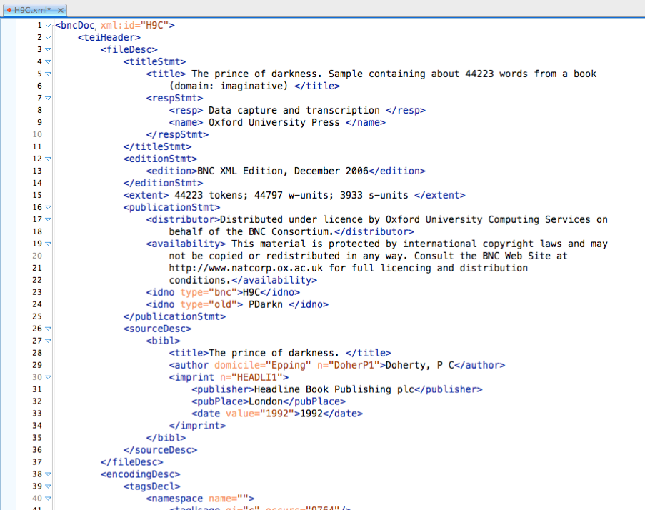
TEI standard (BNC)
TEI header = metadata
text from British National Corpus
information about this text

Slide 25
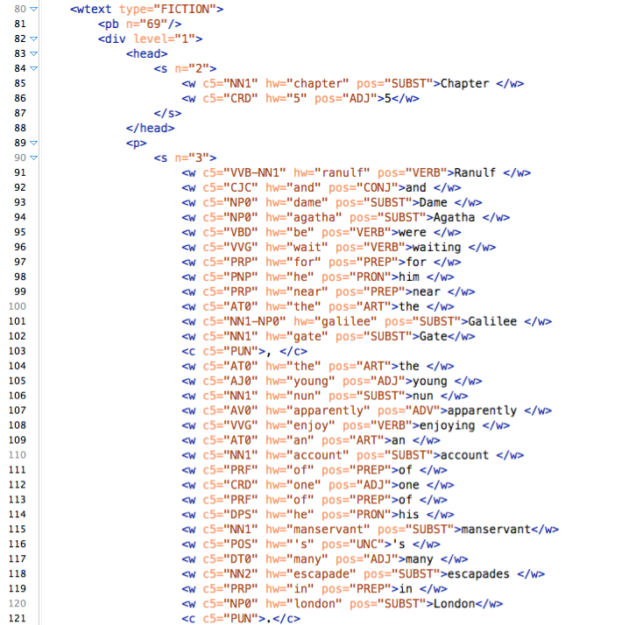
TEI standard (BNC)
TEI body = object data + annotation
structure & typographic markup
tokens + token-level annotations
principle:
raw text (= object data) can be reconstructed by deleting all XML tags

Slide 26
Vertical text format (.vrt) Simpler, more efficient format ➞ used by CWB & NLP tools
<corpus>
<story title="The Garden">
<p>
<s>
It PP it
seemed VBD seem
a DT a
day NN day
much RB much
as IN as
any DT any
other JJ other
until IN until
I PP I
...
</s>
</p>
</story>
</corpus>
metadata
title: The Garden
author: Stefan Evert
author sex: male date: 05.08.1991
TAB characters (\t, \x09)

Slide 27
Vertical text format (.vrt) Text metadata encoded in XML start tags (not in header!)
<corpus>
<text title="The Garden" author="Stefan Evert" author_sex="male" date="1991-08-05">
<p num="1">
<s>
It PP it
seemed VBD seem
a DT a
day NN day
much RB much
as IN as
any DT any
other JJ other
until IN until
I PP I
...
</s>
</p>
</text>
</corpus>
CQPweb requires <text>, SketchEngine prefers <doc>
sub-text level metadata

Slide 28
CoNLL format Vertical text without the metadata
http://universaldependencies.org/docs/format.html
# story: "The Garden"
# paragraph #1
1 It PP it
2 seemed VBD seem
3 a DT a
4 fine JJ fine
5 day NN day
6 . SENT .
1 There EX there
2 was VBD be
3 an DT a
4 elephant NN elephant
5 . SENT .
# this is the end of the file
these are just comments
blank lines = sentence boundaries
token numbers (within sentence)

Slide 29
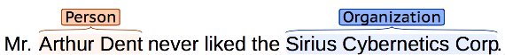
Corpus annotation: segments and structures
Automatic recognition and categorization of particular word sequences (segments)
e.g. named entities (NER = named entity recognition)
e.g. time and place expressions: last week, the day after tomorrow, September 15th, in Paris, on the lawn in front of their house, …
e.g. text spans that need to be masked for anonymization purposes

Slide 30
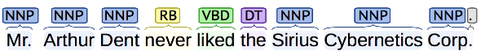
Corpus annotation: segments and structures
Syntactic phrase structure analysis = parse tree of nested segments corresponding to syntactic units
„minimal“ phrases as flat segments ➞ chunk parsing
S
VP
NP
AdvP
NP

Slide 31
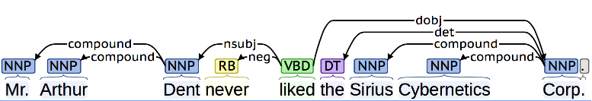
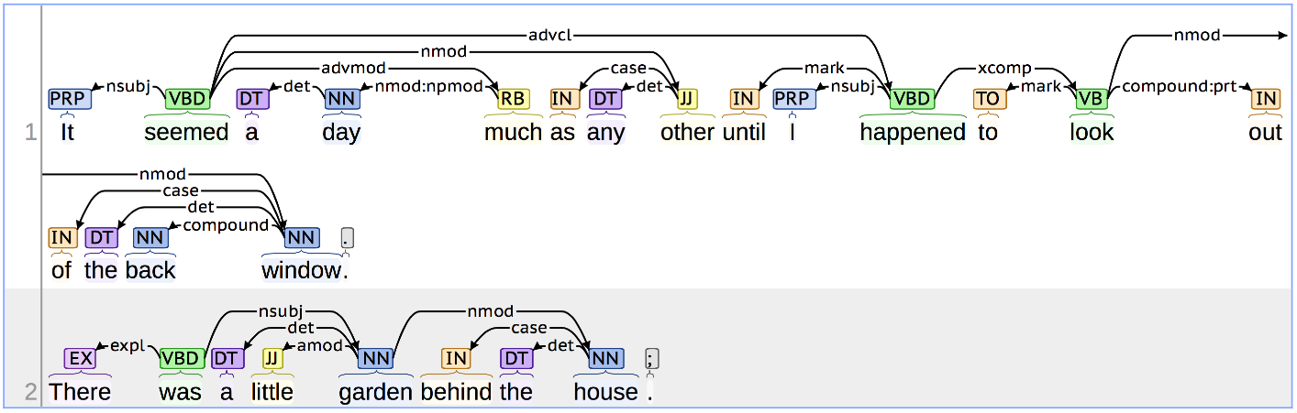
Corpus annotation: syntactic dependency analysis
Try it for yourself at http://corenlp.run/

Slide 32
Sentence alignment for parallel corpora
Das stört mich keineswegs, ich halte das für eine gute Initiative, aber wiederum ist Europa nicht zur Stelle. | That is no problem for me.
 | I think it is a good initiative, but again Europe is absent.
Es darf nicht wieder geschehen! | It should not happen again, Mr President.
Meine Fraktion verlangt, daß die italienische Präsidentschaft hier vor uns erklärt, welche Rolle sie spielt. | My Group wants the Italian presidency to come here and explain what its role is.
Herr Präsident, liebe Kolleginnen und Kollegen! | Mr President, ladies and gentlemen, I think it is important that we should discuss the situation in the Middle East this week.
Ich halte es für wichtig, daß wir diese Woche über die Situation im Nahen Osten reden.
Darin sind wir uns alle einig. | We all agree on that.
Notes:
• Satzalignment = Sätze werden ihren Übersetzungen zugeordnet (in einem Paralleltext)
• I.d.R. wird Alignment vom Übersetzer nicht explizit markiert ➔ muss mit automatischem Verfahren bestimmt werden

Slide 33
Sentence alignment: bitext map
E6 |  |  |  |  |  | ■
E5 |  |  |  | ■ | ■
E4 |  |  | ■
E3 |  | ■
E2 | ■
E1 | ■
 | D1 | D2 | D3 | D4 | D5 | D6
Notes:
• Ansatz: Berechnung von Satzähnlichkeiten (Länge, Eigennamen und Zahlen, bekannte Übesetzungsäquivalente, orthographisch ähnliche Wörter, Wortarten, …)
• dann Suche nach sehr ähnlichen Sätzen in der Nähe der Diagonalen

Slide 34
Sentence alignment as similarity search
E6 |  | ■ |  |  |  | ■
E5 | ■ |  |  | ■ | ■
E4 |  |  | ■ |  | ■
E3 |  | ■ |  | ■
E2 | ■ |  |  | ■
E1 | ■ | ■ |  |  |  | ■
 | D1 | D2 | D3 | D4 | D5 | D6
Notes:
• Ansatz: Berechnung von Satzähnlichkeiten (Länge, Eigennamen und Zahlen, bekannte Übesetzungsäquivalente, orthographisch ähnliche Wörter, Wortarten, …)
• dann Suche nach sehr ähnlichen Sätzen in der Nähe der Diagonalen

Slide 35
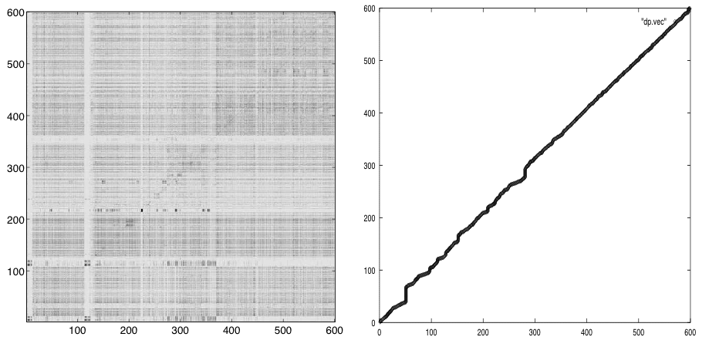
Sentence alignment as similarity search

